Slide 1
Examining The Effect of the 1033 Program on Police Shootings
Manny Darko, Juliana Kennedy, Philip Silberman

Slide 2
1033 Background
Established in 1990, the 1033 Program (formerly the 1208 Program) permits the Secretary of Defense to transfer, without charge, excess U.S. Department of Defense (DoD) personal property (supplies and equipment) to state and local law enforcement agencies (LEAs).

Slide 3
Research Outline and Questions
Since 1990, the 1033 program allowed police to obtain unused Department of Defense equipment:
What sorts of equipment are police receiving?
Where is this type of equipment being allocated?
How much money is going into this program?
Is there a relationship between the increase in police shootings and the possession of military equipment?
Are there any notable trends among victims of police shootings?

Slide 4
Project Hypothesis
We hypothesize that there is a correlation between the inception of the 1033 program and police fatalities.
We will demonstrate that the 1033 program has resulted in an increased militarization of local law enforcement around the country.
Consequently, the use of force has become more popular among the police force causing the deaths of civilians.

Slide 5
Data Sources
Fatal Police Shootings: data.world.com
Census Data: census.gov
1033 Program Police Gear: data.world.com
Geo Data: eric.clst.org/tech/usgeojson/
National Stock Number (NSN)decoding: www.acquisition.gov
Notes:
4. Via United States Census Cartographic Boundary Files
Manny

Slide 6
Data Exploration Methods
1033 and PSC Manual Data
Cleaning - Pandas
Shaping and Pivoting Data - Pandas
Plots - Plotly, Cufflinks
Fatalities Data
Shaping - Pandas
Plots - GeoPandas, GeoPlot
Notes:
Juliana

Slide 7
1033 Data Cleansing
Cleansing the 1033 data was challenging for the following reasons:
Data Coarseness
Irrelevant Records
Missing Information
Supplemented by PSC Manual Data.
Esoteric Subject Matter
Notes:
The 1033 data made available via Data World is vast and coarse/dirty.
~245K records. After cleansing, 237K remained.
It also contained data that is not relevant to our research.
For example office furniture made up a prominent amount of this data that would skew our analysis and lead to false conclusion that you could tie quantity and cost to increased militarization.
To address this issue, we limited the data to those with NSN codes categorized as Vehicles, Weapons and Ammunition.

Slide 8
How do we know what is being distributed via 1033?
1005-00-073-9421
NSN
The NSN (National Stock Number) attribute categorizes each item. The PSC (Product and Service Code) is the first four characters in the NSN.
We added descriptions per the Product and Service Code Manual made available by acquisition.gov.
1005
PSC
10
Group
05
Class
Notes:
PSC Manual

Slide 9
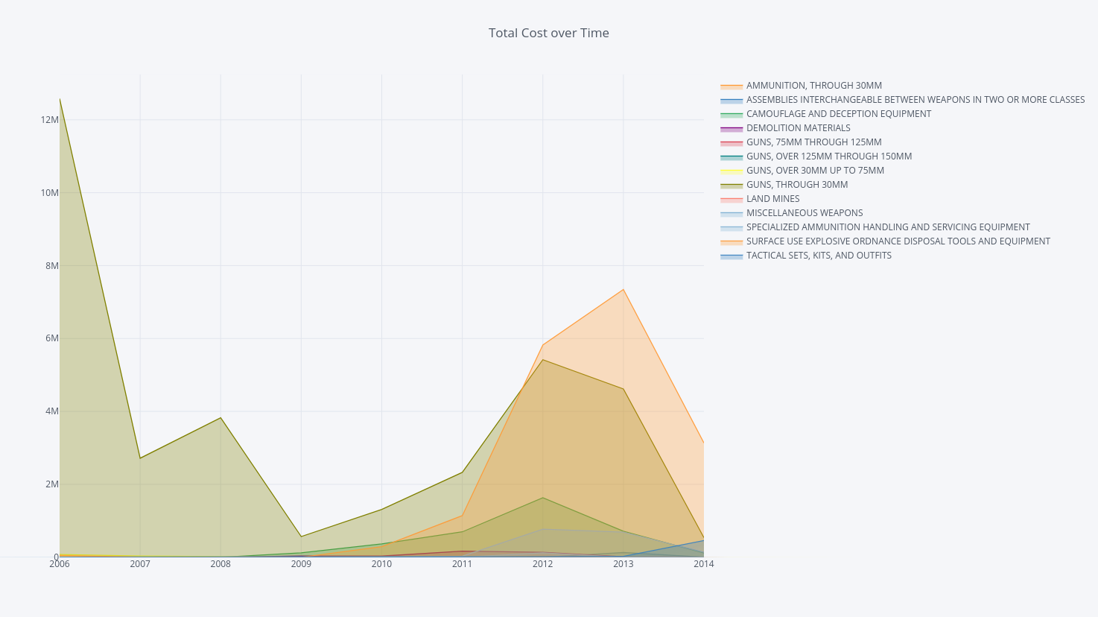
1033 Distribution of Capital over Time
The cost in 2006 peaked because of the steady distribution rifles to California during that year.
The capital distribution began to rise again in 2009 through 2013.
Notes:
RIFLE,5.56 MILLIMETER

Slide 10
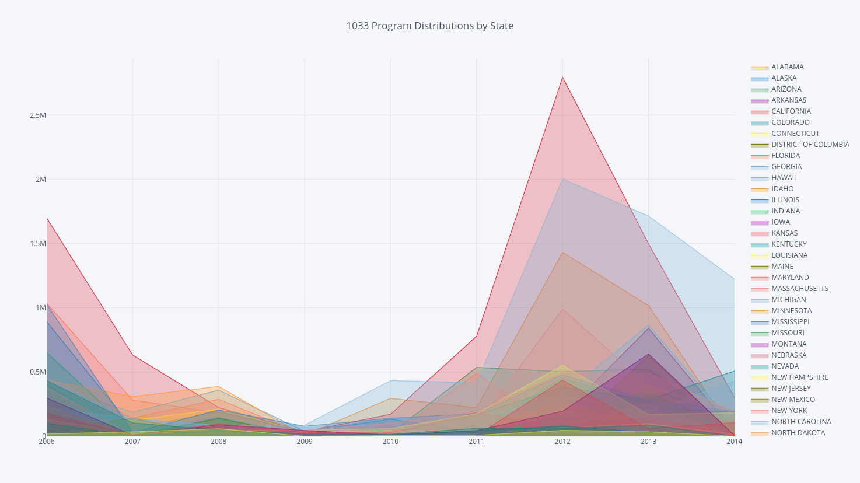
1033 Distribution over Time by State
The redistribution of military equipment briefly rose in 2006 and then declined until 2009 when it began a steady climb through 2013.
Notes:
Military equipment = weapons and ammunition
What happened during that time?

Slide 11
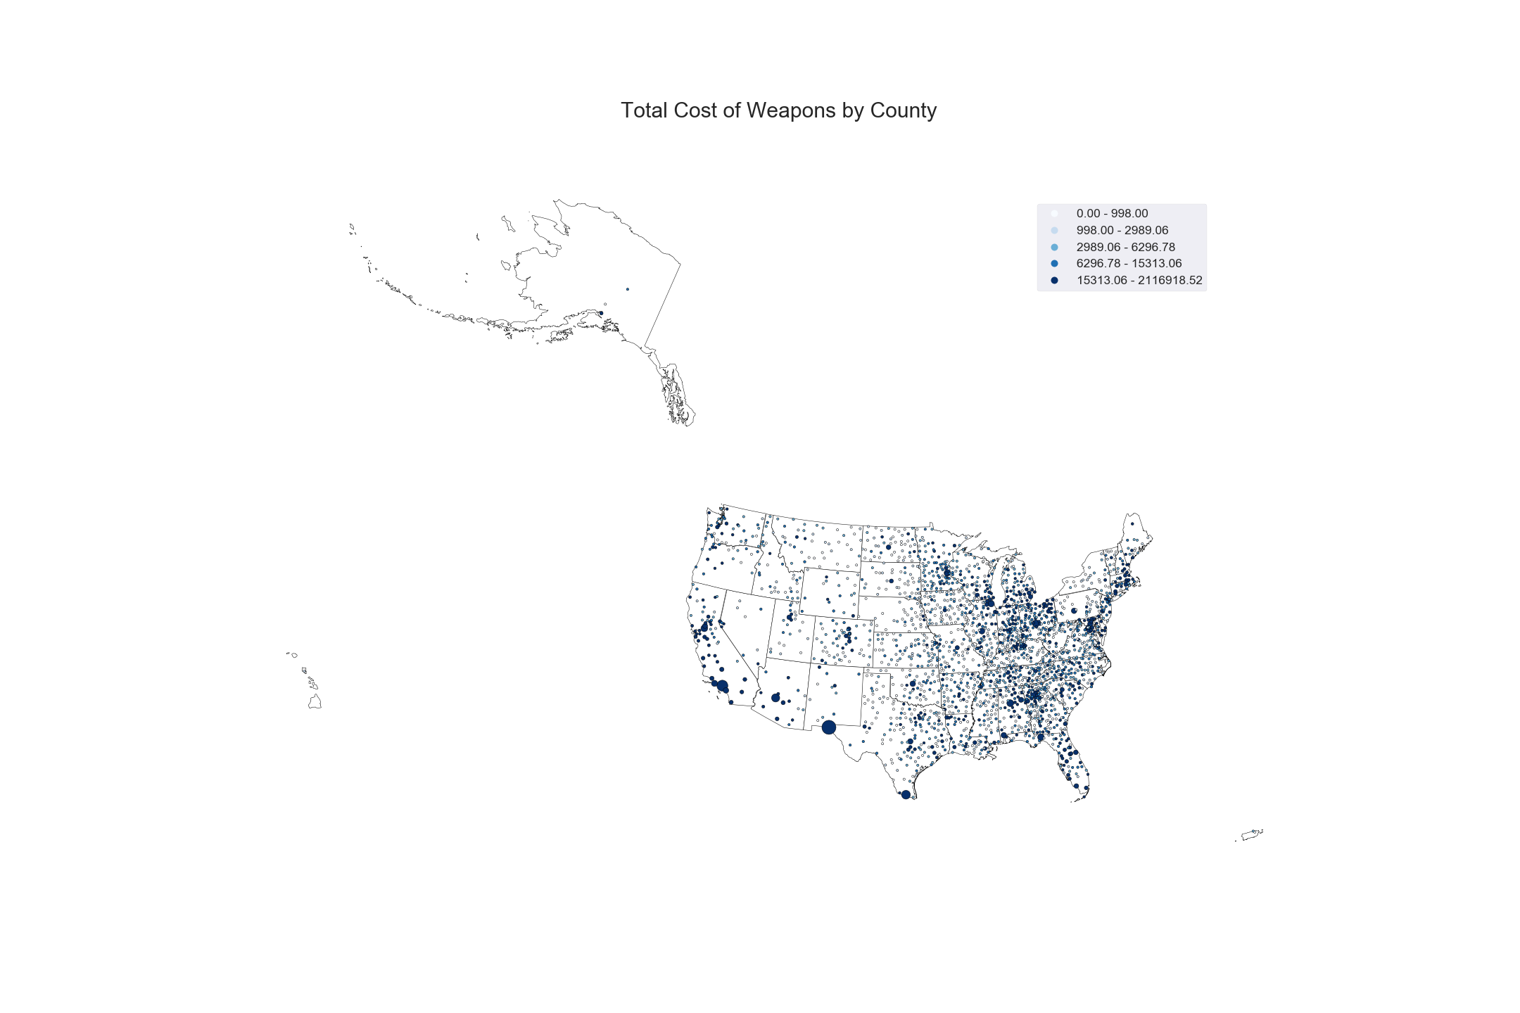
Distribution of Capital By County

Slide 12
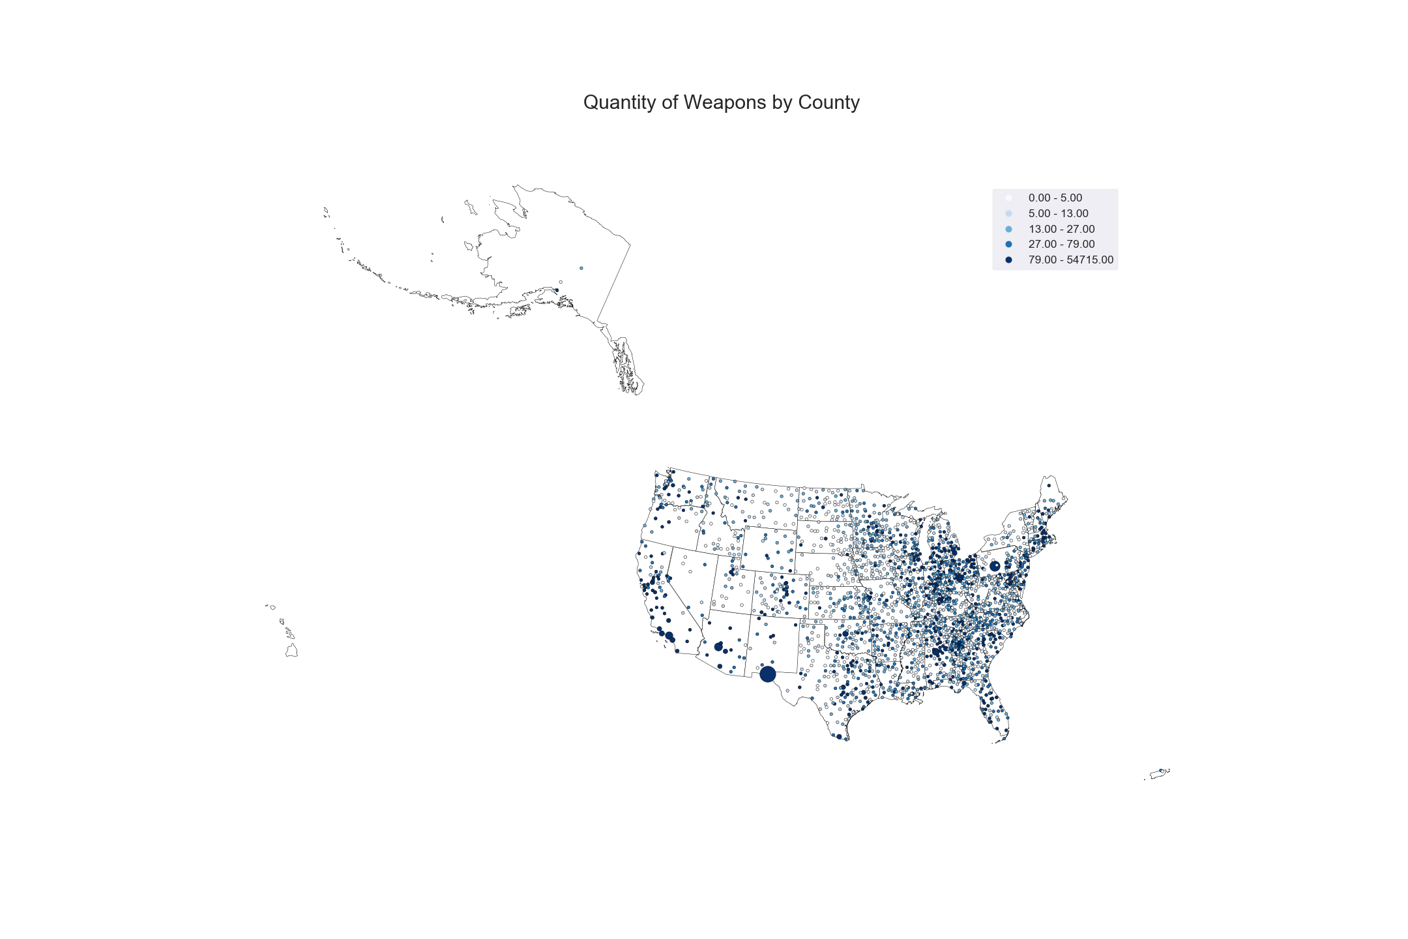
Distribution of Quantity By County

Slide 13
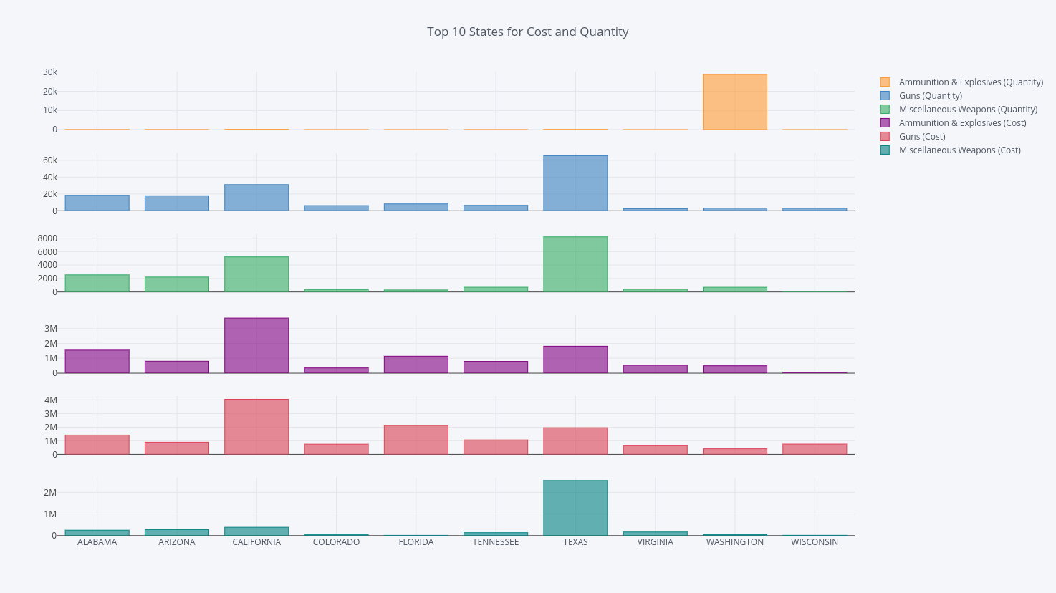
Top 10 States by Distribution of Capital vs Quantity
Volume (Quantity) is not always indicative of the capital distributed.
Notes:
RIFLE,5.56 MILLIMETER

Slide 14
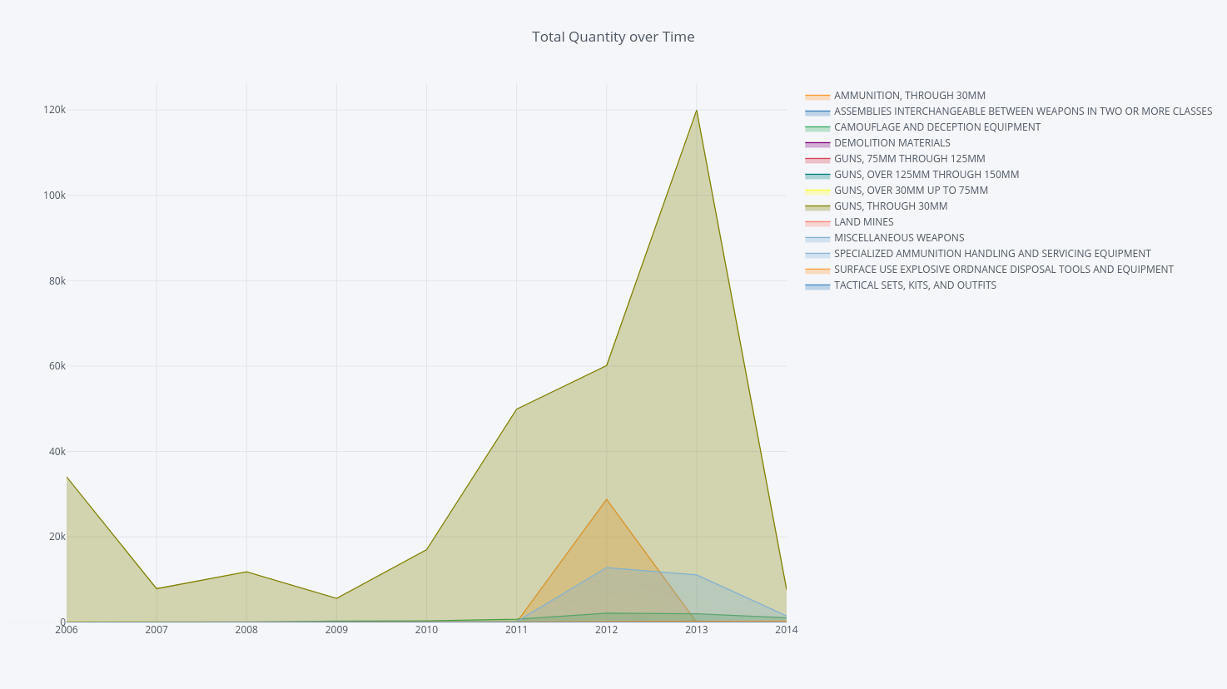
1033 Item Quantity over Time
Remember those rifles from 2006? They were expensive but not numerous. The volume of 1033 distribution actually began its steady incline in 2009. The distribution of guns (especially up to 30mm) peaked in 2013 at 120K units across The United States.
Notes:
RIFLE,5.56 MILLIMETER

Slide 15
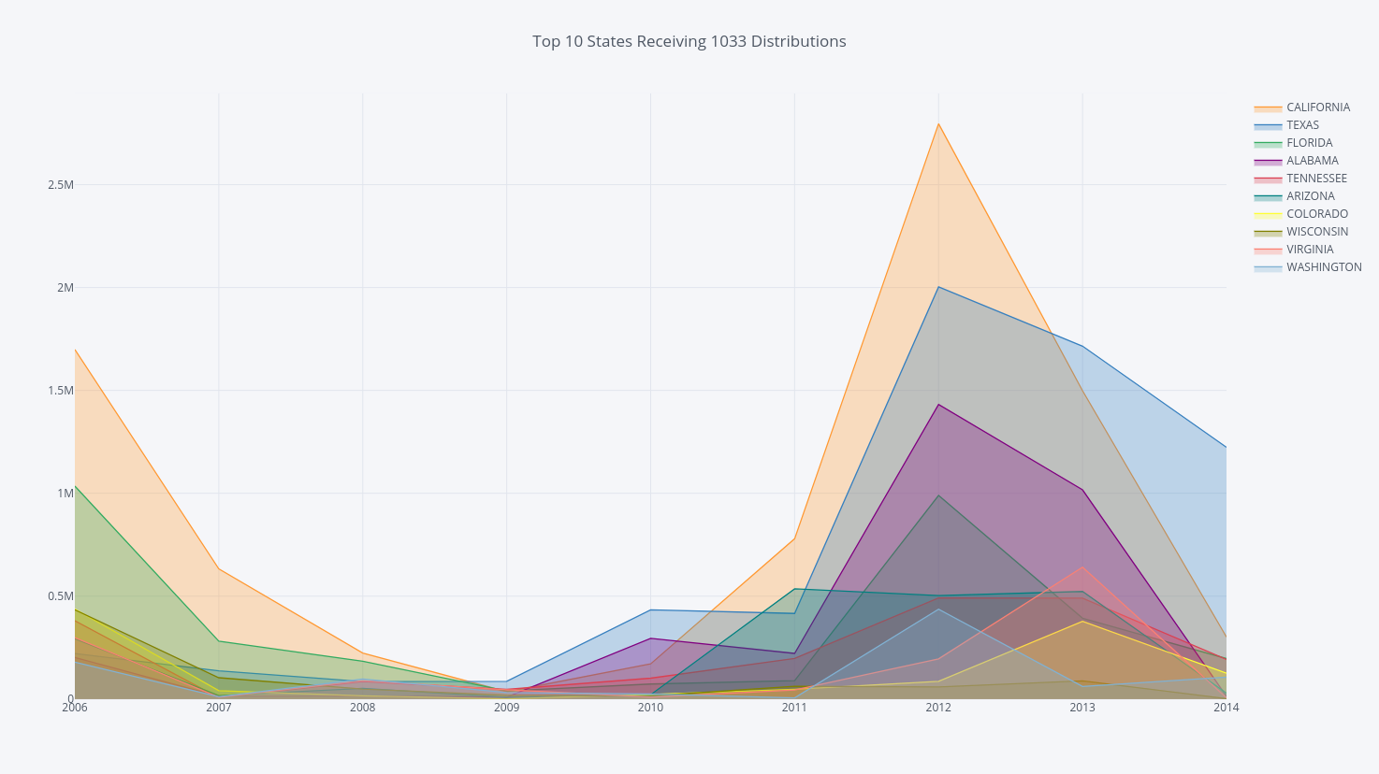
Top 10 States by Distribution of Capital
We limited our data set to the States that received the most valuable distributions over time.
California
Texas
Notes:
RIFLE,5.56 MILLIMETER

Slide 16
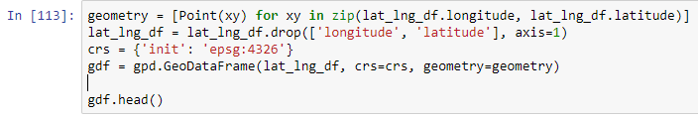
Fatalities Data Cleaning Snippet
The police fatalities data was relatively clean; only hiccup is defining armed vs. unarmed
Trickiest aspect was formatting the data for geoplot
Seemingly easy adjustments to the state name were surprisingly time consuming

Slide 17
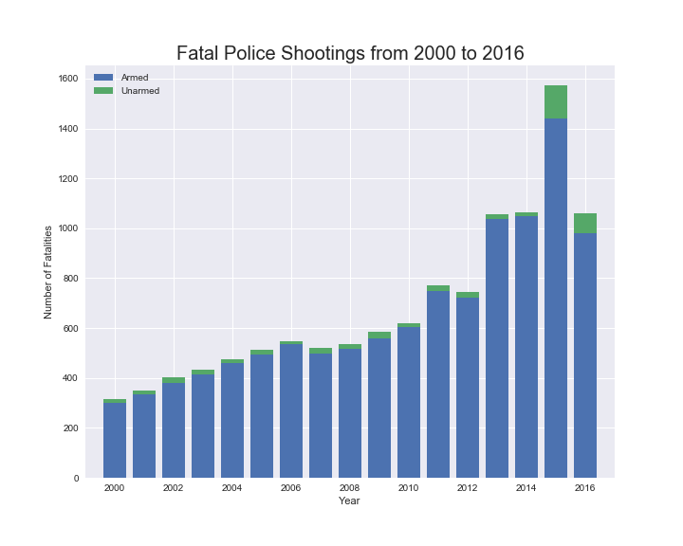
Fatalities Over Time
Steady rise from 2000, with a huge spike in 2015
Given the dataset’s limitations it’s unclear if 2015 or 2016 are outliers
Proportion of unarmed vs armed is relatively static, though the definition is fuzzy

Slide 18
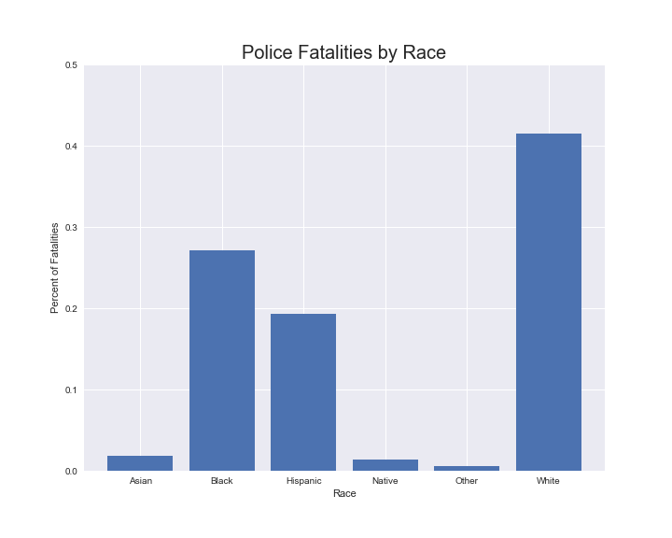
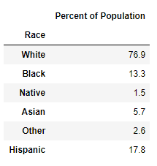
Fatalities By Race
Notable about this plot is the difference between these percentages and percentage of the US population at large.

Slide 19
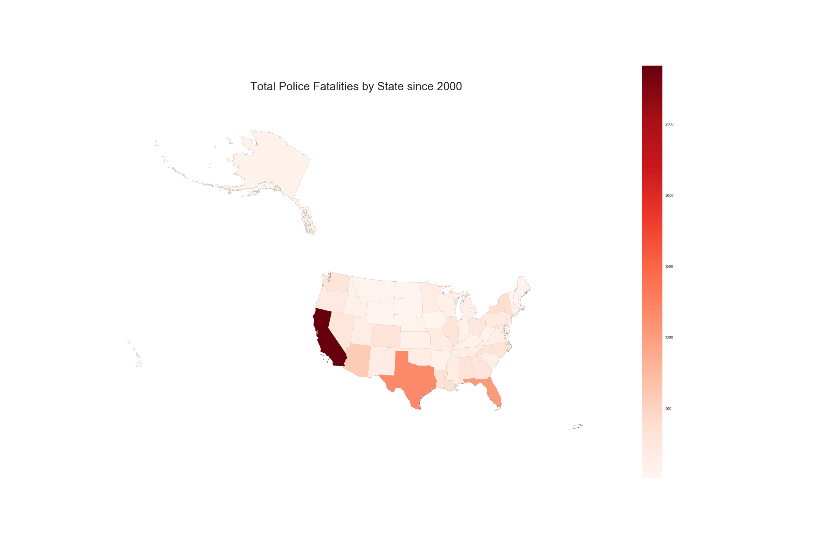
Fatalities By State
Notable high points are California and Texas
Should be adjusted by population in order to get a more clear picture

Slide 20
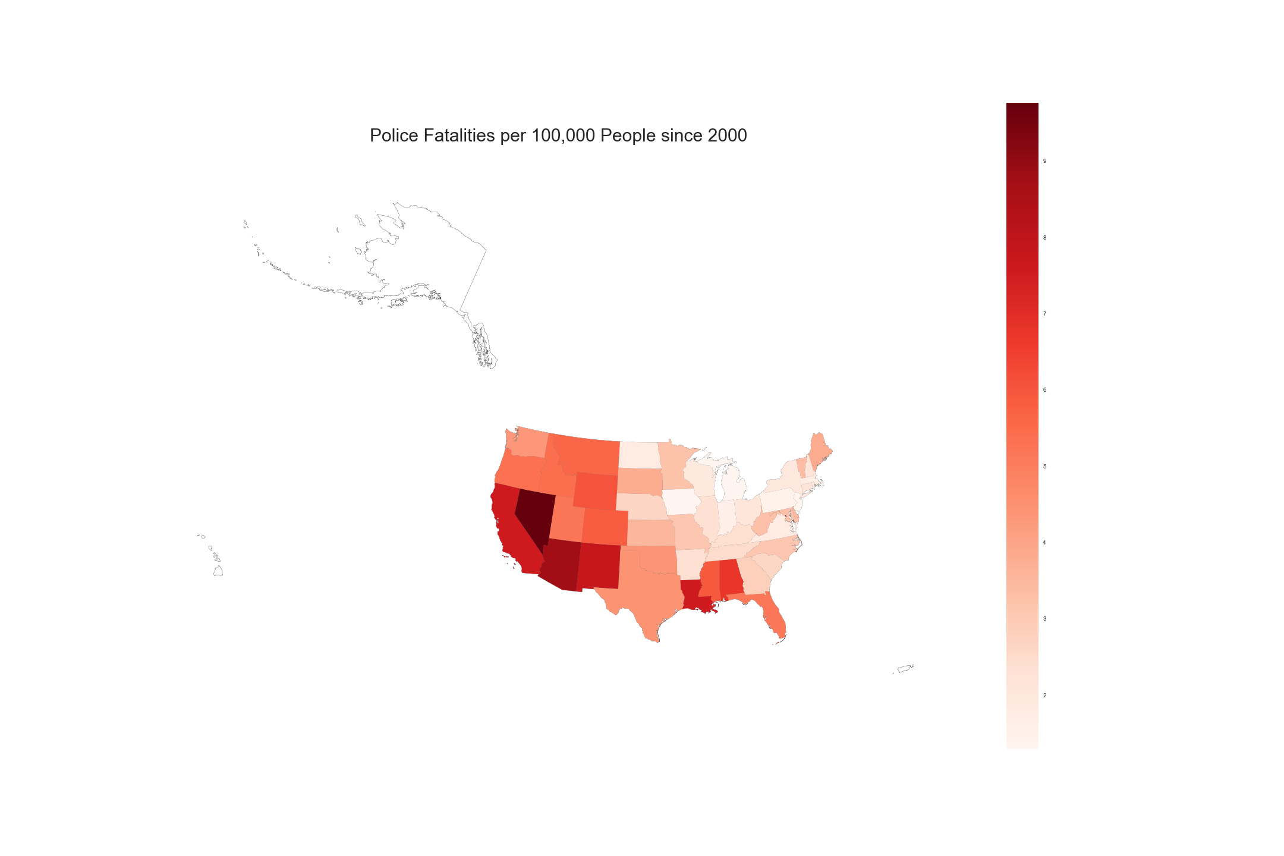
Fatalities adjusted by population
Very different story than the last plot
Much more even high points across the west coast and gulf coast

Slide 21
Summary of Analysis
There was a demonstrable increase in police fatalities from 2000 to 2016, culminating in a massive spike in 2015.
The 1033 program is widely used nationwide (both by quantity and capital) and significantly increased in usage from 2010 to 2014. Additionally, there is a huge variation of types of equipment which obfuscates the research question.

Slide 22
Implications of Analysis
The results we see in our datasets show similar trends in what we see represented in the news today; greater police and civilian deaths; unfair treatment of minorities and a more militarized police force.
We cannot draw conclusive judgements on the correlations, but there is enough of a correlation to warrant further investigations.

Slide 23
Fun Facts
The largest distribution of guns was made to Texas in 2013.
53,177 guns valued at $757K
Texas also received 37(the largest distribution) of “Mine Resistant Vehicles” valued at 24M.
Florida has received 155 aircraft, mainly helicopters, valued at 214M
Although the quantity of individual distributions were greater on the west coast, there were many more individual distributions east of the Mississippi.
Many states that were in the top 10 for receiving guns, were also the top recipients of body bags.
OH! And someone got 100 swords and scabbards.

Slide 24
Challenges and Limitations
Variables: there are too many of them
We attempted to investigate a potential relationship regarding a very complex question, but there are so many outstanding variables we did not consider.
We attempted to limit the data we considered but this will naturally limit analytical capabilities.
Government data is messy and reported data doesn’t always tell the whole story
Technical challenges: more plots, more problems
Incorporating a number of new modules was time consuming and challenging and Python may not be the best tool for this type of analysis
The same plots in Tableau would take far less time, but it’s good to know the limitations of our tools.

Slide 25
Thanks for your questions

